Slide 1
CS 4215: Quantitative Performance Evaluation for Computing ystems
Lydia Y. Chen
y.chen-10@tudelft.nl

Slide 2
Comparison questions?
Q1. You are looking for a computing cloud to host your websites so that the average latency is minimized. Which cloud provider? What kind of VMs? How many VMs?
Q2. You design a (machine learning) algorithm, which has many parameters. How do you set the parameters such that the computing time and the algorithm accuracy are maximized?

Slide 3
Learning objective
You will be able to design experiments which can capture the effects and their integrations
You will be able to analyze the experimental results and assess its significance

Slide 4
Design experiment is about
designing a proper set of experiments for measurement or simulation
developing a model that best describes the data obtained
analyzing the goodness of mode vis errors and variances

Slide 5
Last week
Characterization
Modeling
Predicting
Resource management

Slide 6
Terms and Definition

Slide 7
Terminology
Response variable: outcome, e .g., response time
Factors ( predictors): variables that affect the response variable, e.g., VM type, and parameter.
Levels (treatment): The values that a factor can assume, e.g., number of cores per VM
Replication: Repetition of all or some experiments.
Design: The number of experiments, the factor level and number of replications for each experiment.
E.g., Full Factorial Design with 5 replications: 3× 3 × 4 × 3 × 3 or 324 experiments, each repeated five times.

Slide 8
Types of Experimental Designs
Simple Designs: Vary one factor at a time
Not statistically efficient.
Wrong conclusions if the factors have interaction.
Full Factorial Design: All combinations.
Can find the effect of all factors.
Too much time and money.
E.g., 2 factorial where each of n factors has 2 levels. # of experiments = 2^n/
Fractional Factorial Designs: Less than Full Factorial
Save time and expense.
Less information.
May not get all interactions.
Not a problem if negligible interactions
Not recommended
Replication is important for all experiments!!!!

Slide 9
Designs you will learn …
One factorial
Two factorial
Full factorial
Partial factorial

Slide 10
Analysis of results
Goodness of fit:
Errors
Variation from factor
Analysis of variation (ANOVA) and F-test
Importance ≠ Significance
Important ⇒ Explains a high percent of variation
Significance ⇒ High contribution to the variation compared to that by errors.
Confidence interval of estimated effect

Slide 11
One Factorial Design

Slide 12
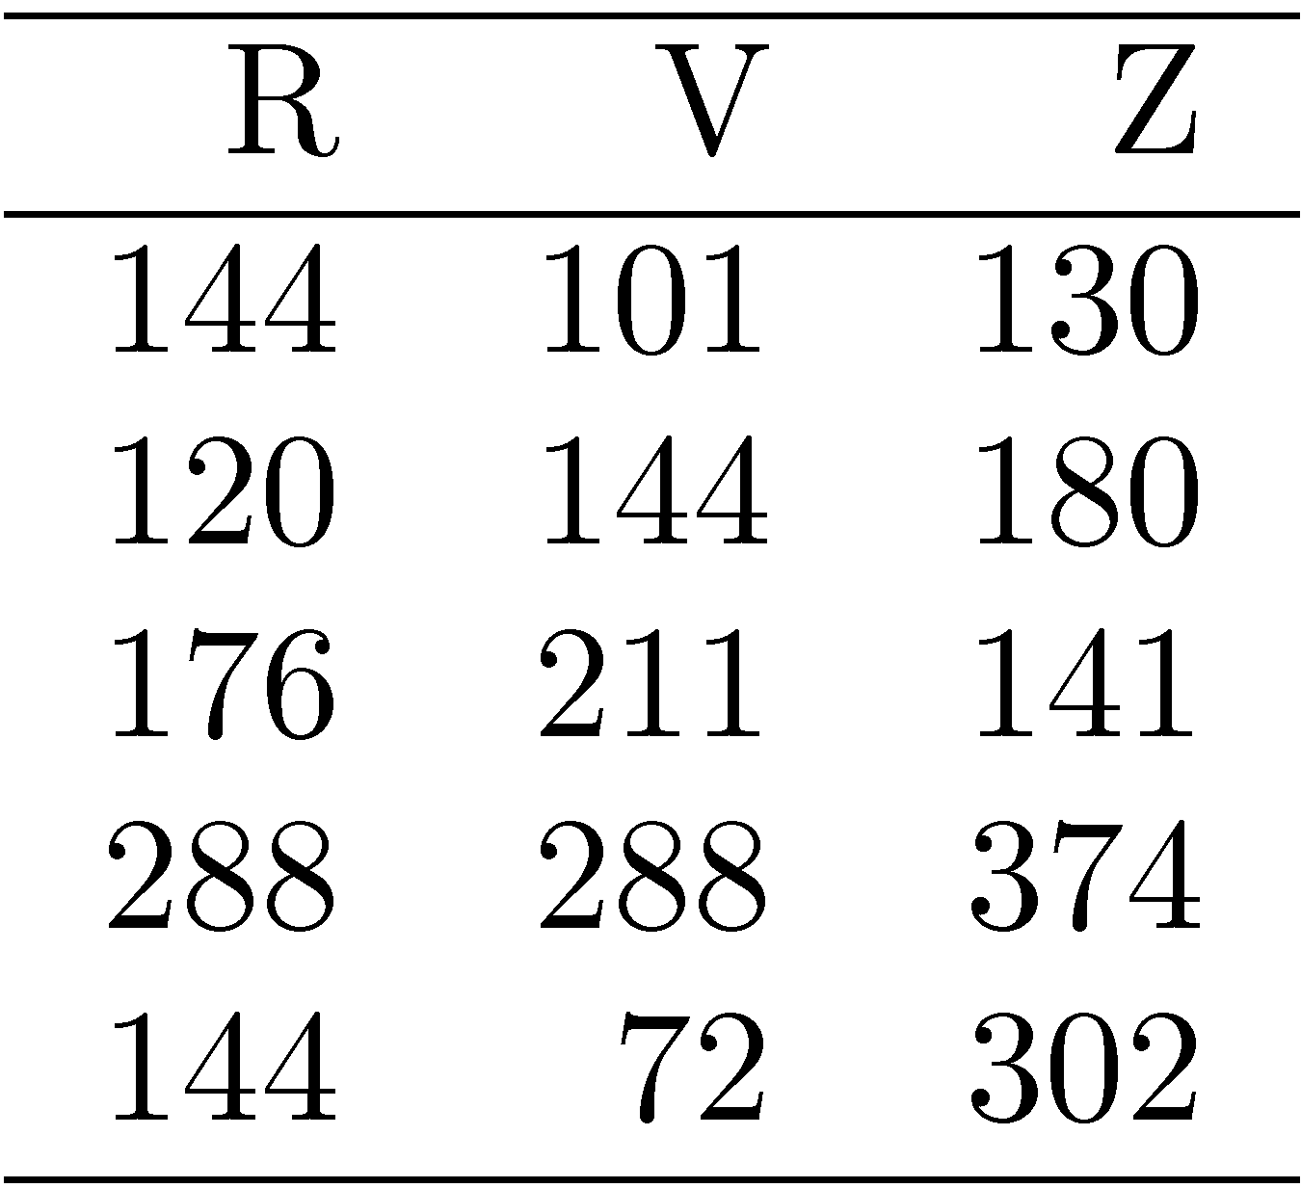
Examples of one factor experiment: An algorithm has three versions: R, V, Z. Which version gives the lowest response time? What’s their average performance? ➔ Run each version 5 times?

Slide 13
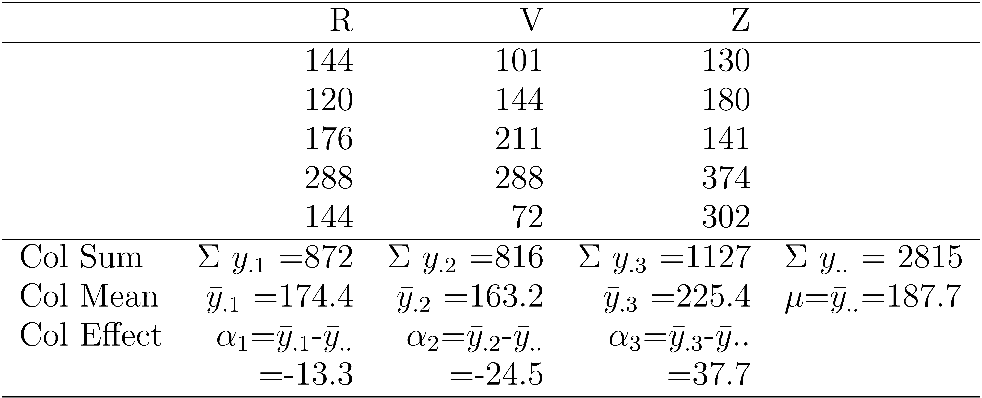
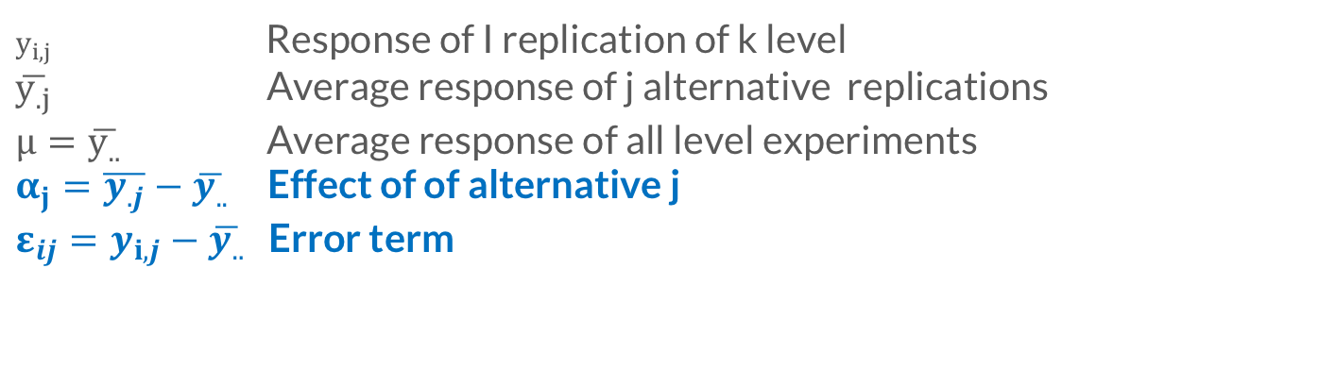
Intuition
-Average algorithm requires 187.7 second of computing time.
-The effects of the R, V, and Z are -13.3, -24.5, and 37.7, respectively.
That is,
R/V/S requires -13.3/-24.5/-37.7 seconds more than an average algorithm.x
$y_{i,j}$ Response of I replication of k level
$\overline{y_{.j}}$ Average response of j alternative replications
$μ=\overline{y_{..}}$ Average response of all level experiments
$α_{j}=\overline{y_{.j}}−\overline{y_{..}}$ Effect of of alternative j
$ε_{ij}=y_{i,j}−\overline{y_{..}}$ Error term

Slide 14
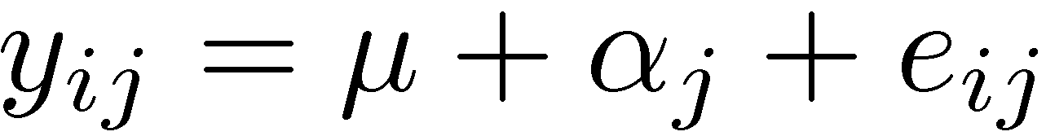
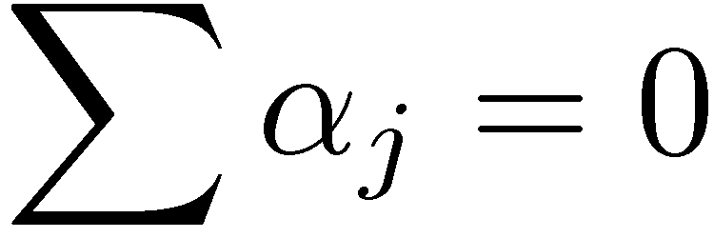
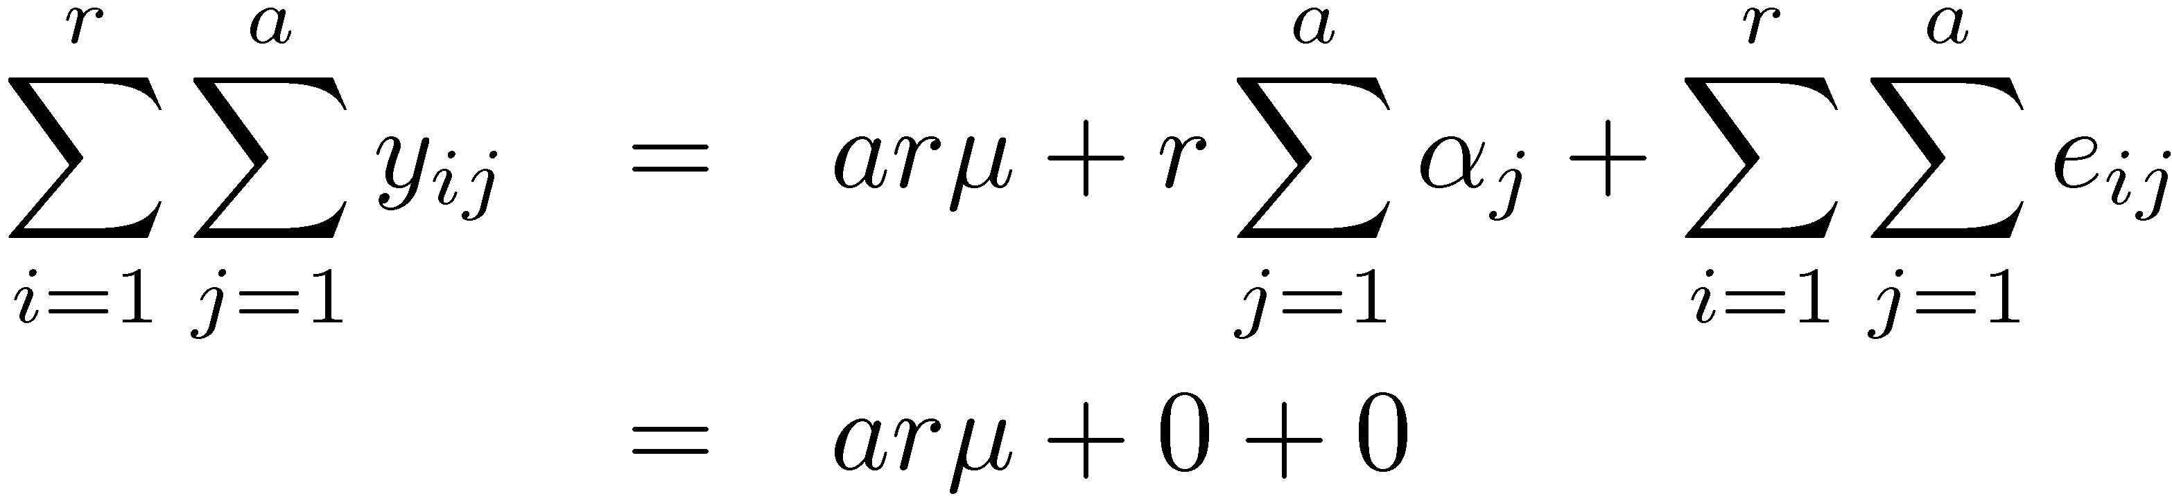
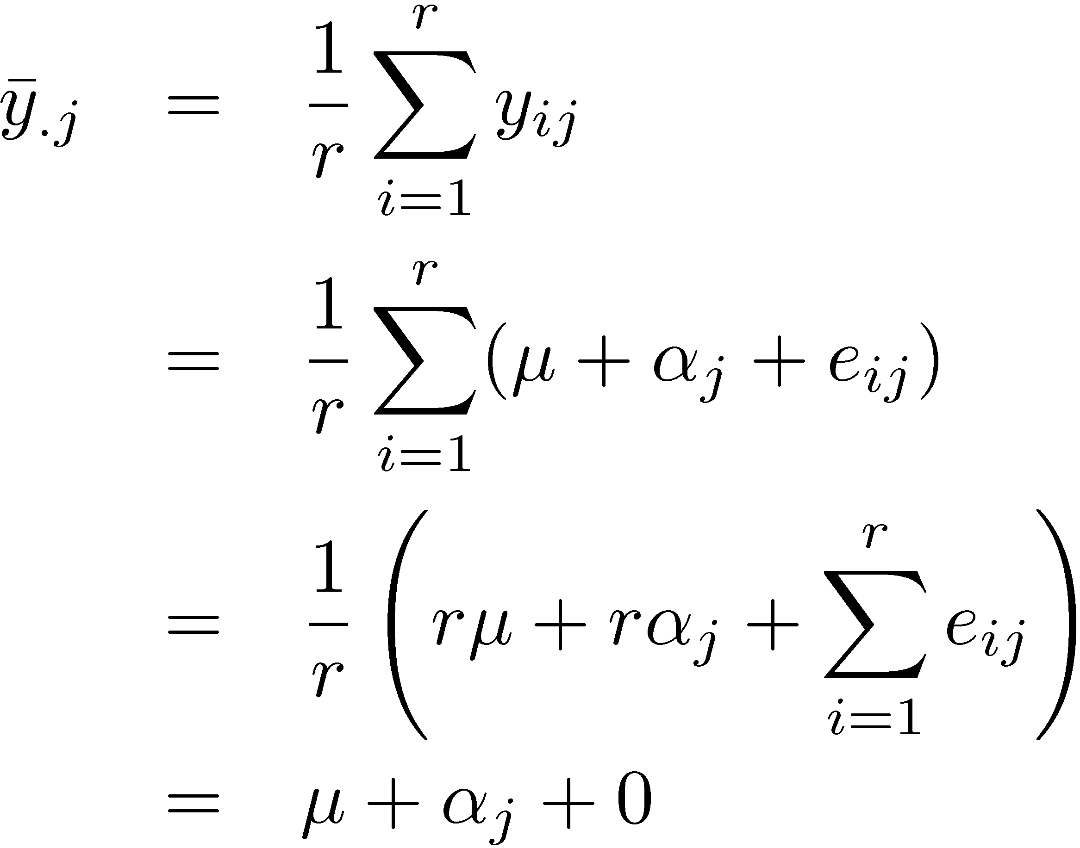
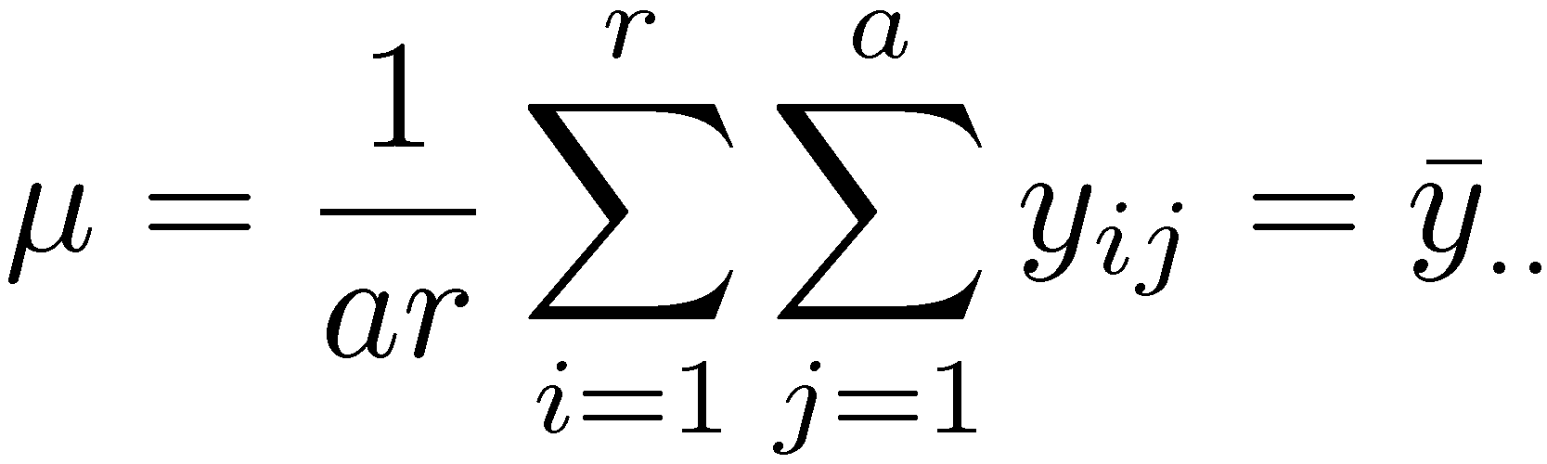
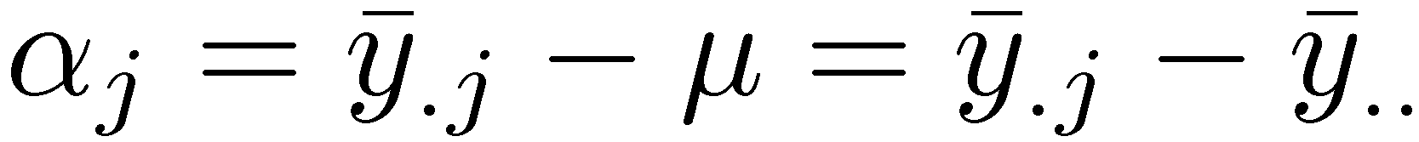
Models
How to get those model parameters from “y”

Slide 15
Analyzing the model:
Allocation of variance (ANOVA):testing model accuracy and confidence
Allocation variations to errors
Importance ≠ Significance
Important ⇒ Explains a high percent of variation
Significance ⇒ High contribution to the variation compared to that by errors.
The ratio between some variances follows F-distribution.

Slide 16
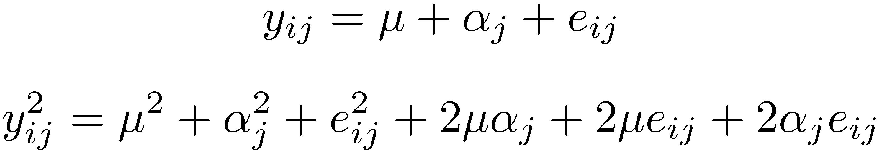
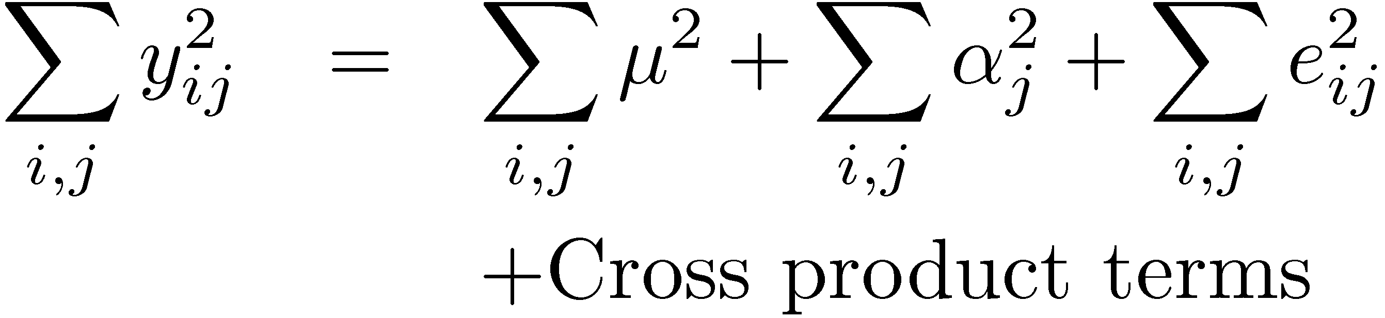
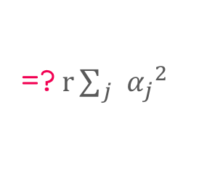
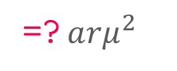
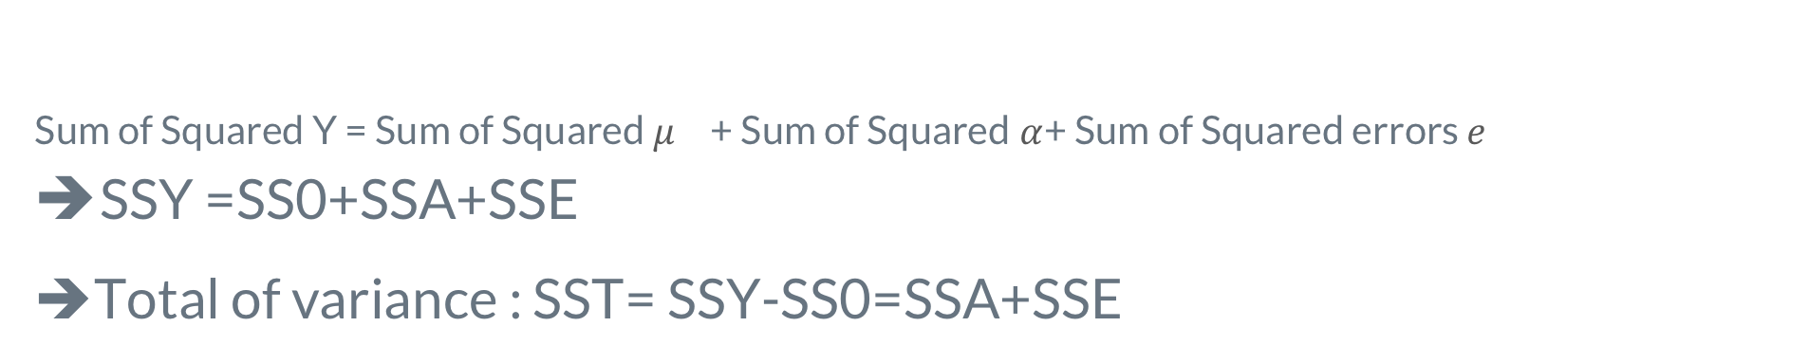
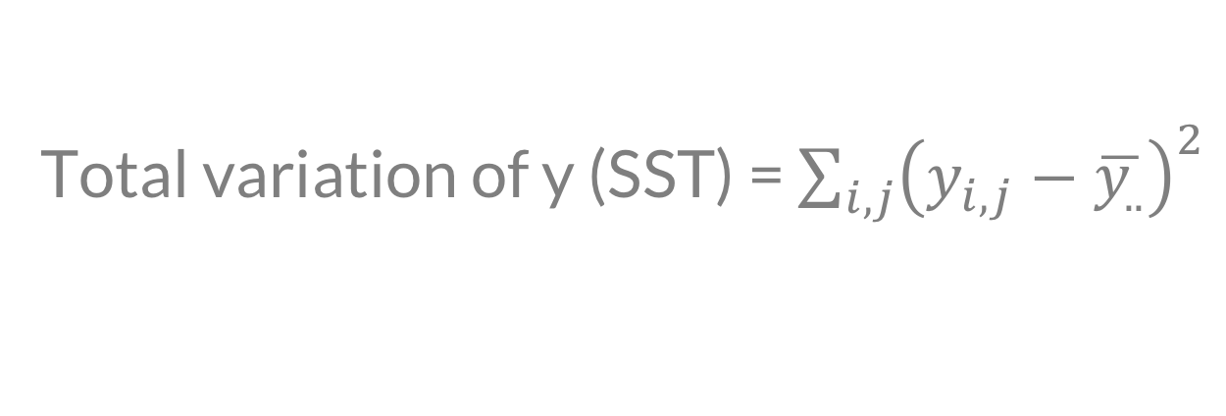
Errors and variation
Total variation of y (SST) = $\sum_{i,j}{{\left(y_{i,j}−\overline{y_{..}}\right)}^{2}}$
=? $arμ^{2}$
=? $r\sum_{j}{{α_{j}}^{2}}$
Sum of Squared Y = Sum of Squared $μ_{}$ + Sum of Squared$α$+ Sum of Squared errors $e$
SSY =SS0+SSA+SSE
➔Total of variance : SST= SSY-SS0=SSA+SSE
goes to 0, Why?

Slide 17
Back to examples
SST=105357.3 , SSA=10992.13, SSE=94365.2
What is the percentage of variation explained by the algorithms?
Is this number statistical significant?

Slide 18
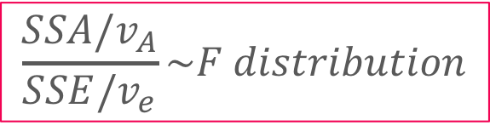
Analysis of Variance (ANOVA)
Degree of freedom = Number of independent values required to compute (Additive)
F-test
Purpose: To check if SSA is significantly greater than SSE
Errors are normally distributed ⇒ SSE and SSA have chi-square distributions.
where ν_{A}=a-1 = degrees of freedom for SSA, ν_{e}=a(r-1) = degrees of freedom for SSE
Computed ratio > F_{[1- α; νA, νe]} ⇒ SSA is significantly higher than SSE.
SSY = SS0 +SSA +SSE
ar | 1 | a-1 | a(r-1)
$$\frac{SSA/v_{A}}{SSE/v_{e}}\sim F distribution$$

Slide 19
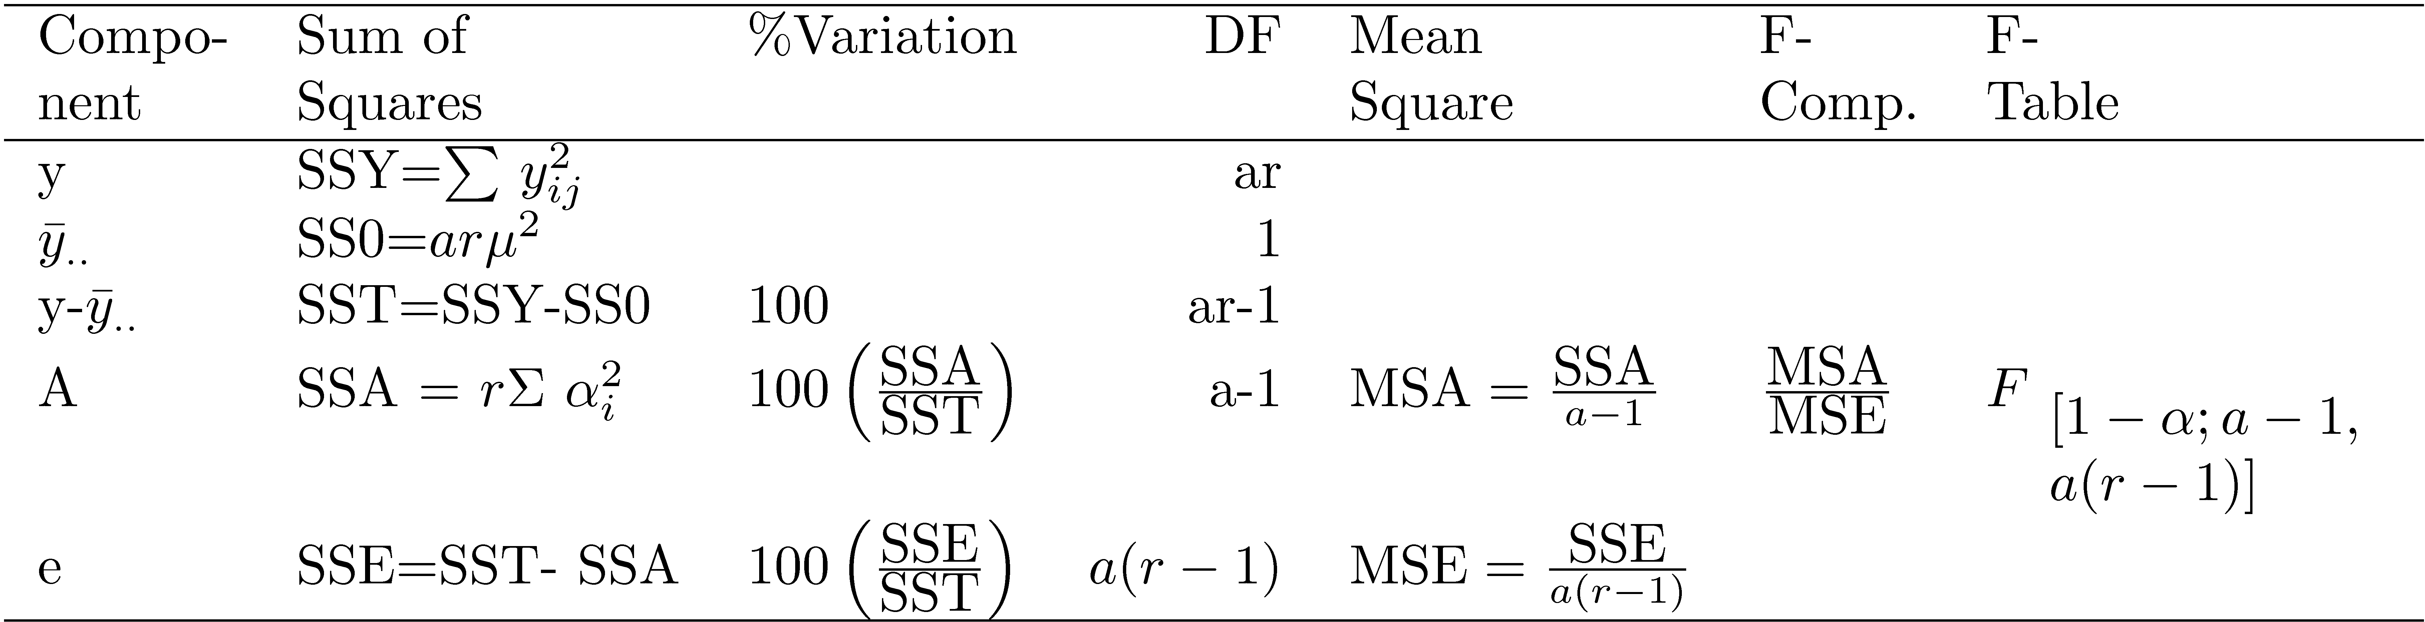
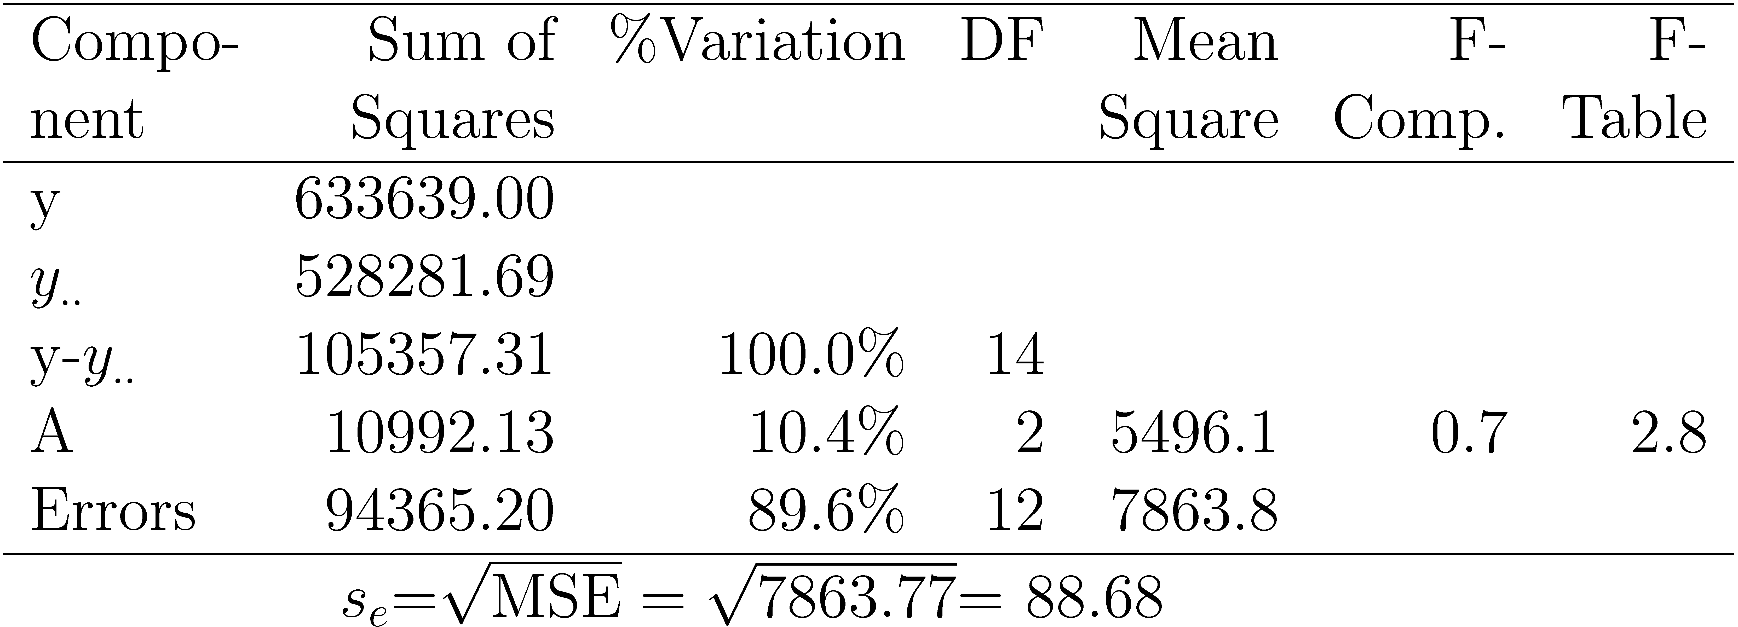
ANOVA Table for One Factor Experiments:
Standard
output
Back to algorithm example
Is difference among algorithms significant?

Slide 20
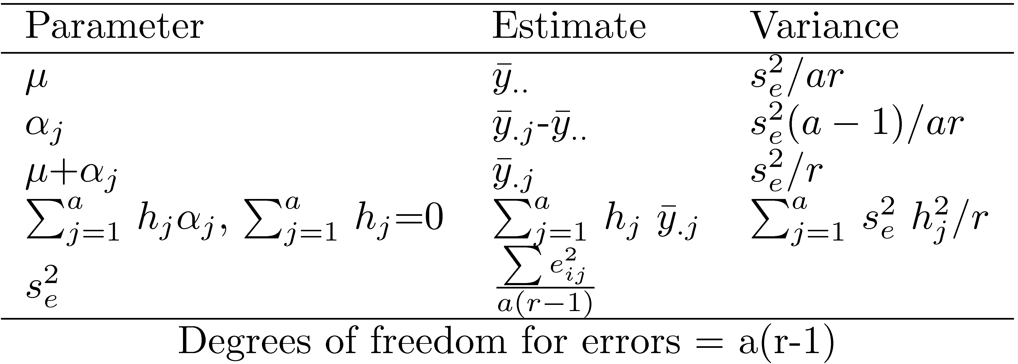

Confidence of parameter
$$Parameter estimate \sim T distribution$$
Why T distribution?
What is the degree of freedom?
how?

Slide 21
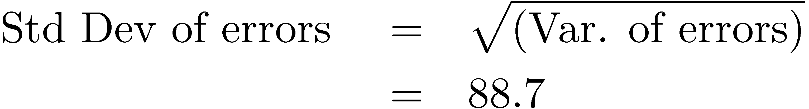
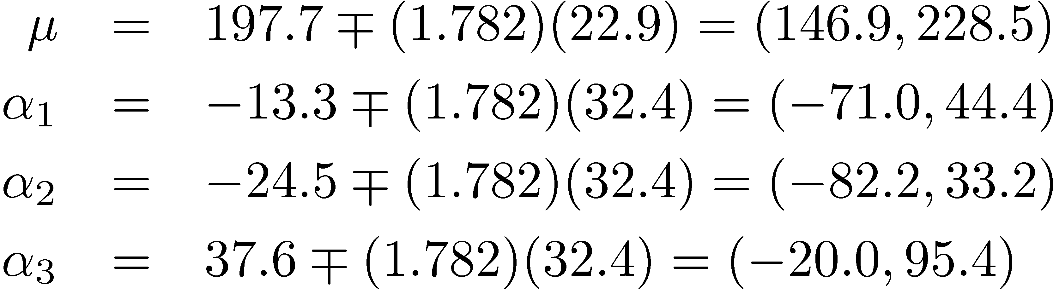
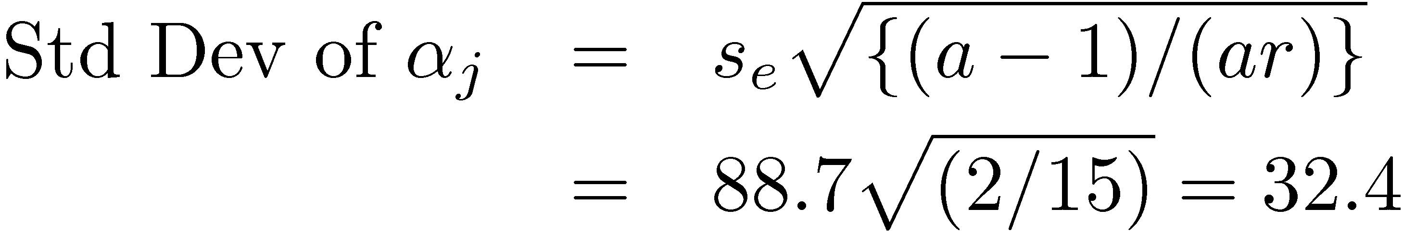
Example of algorithms comparison
How to interpret these results? Think about where 0 is
For 90% confidence, t_{[0.95; 12]}= 1.782.

Slide 22
Two Factorial Design

Slide 23
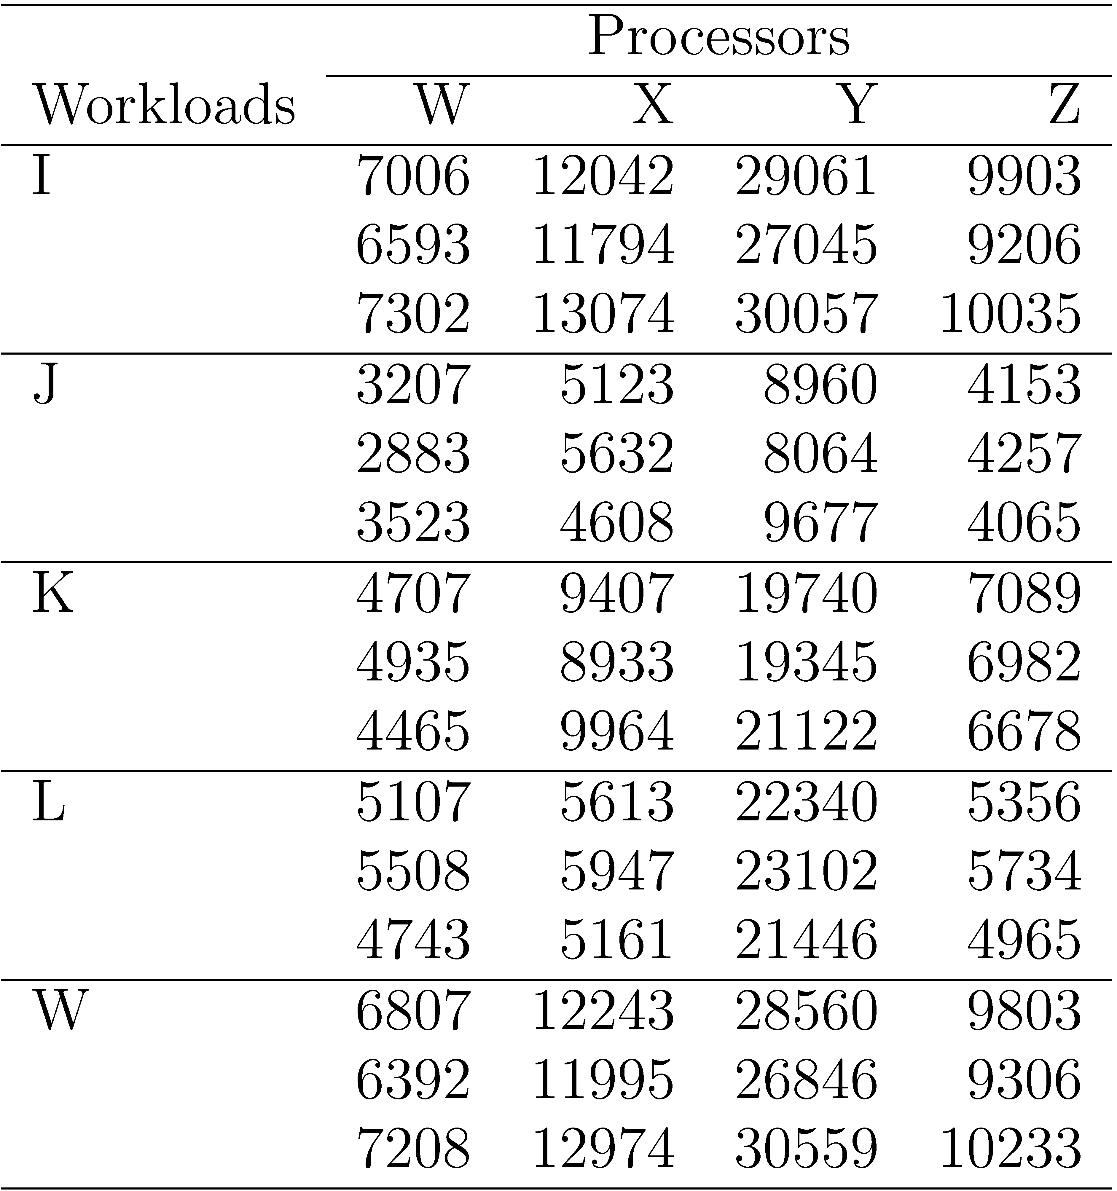
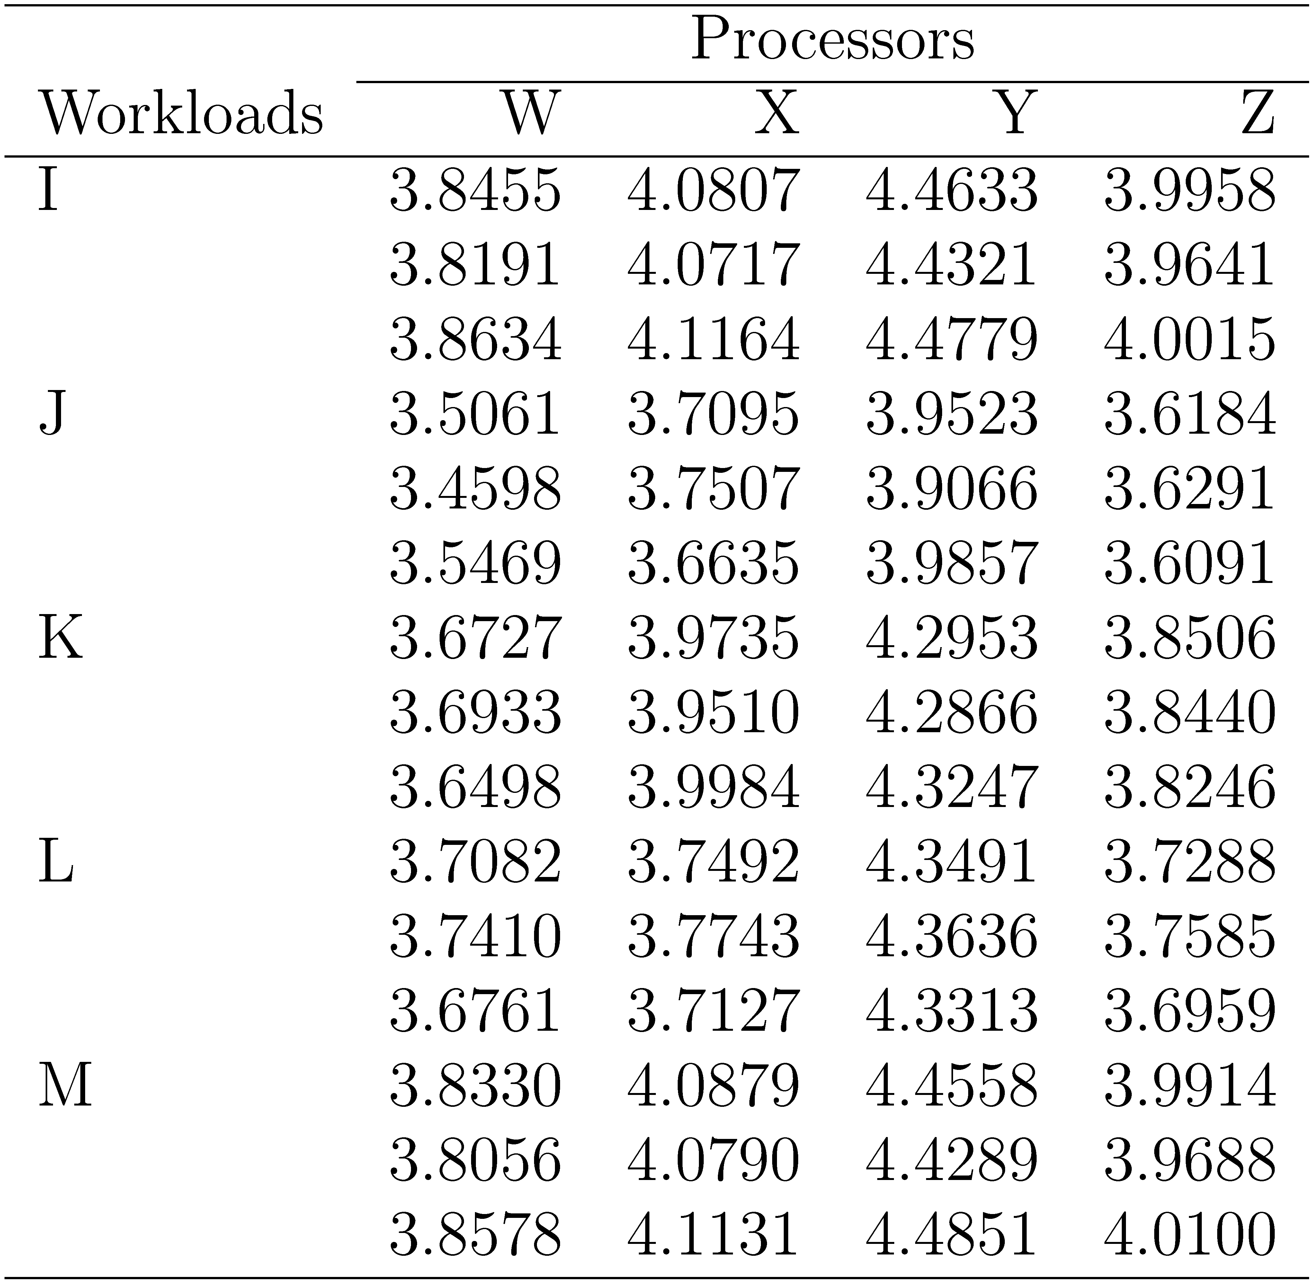
Examples of two factor experiment: Understanding how code size is impacted by the workloads and processors. Run each combination 3 times.
Log Transformation

Slide 24
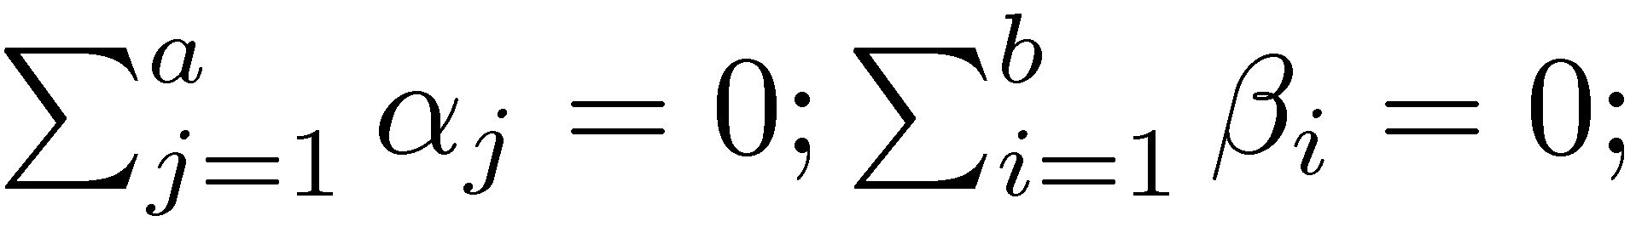
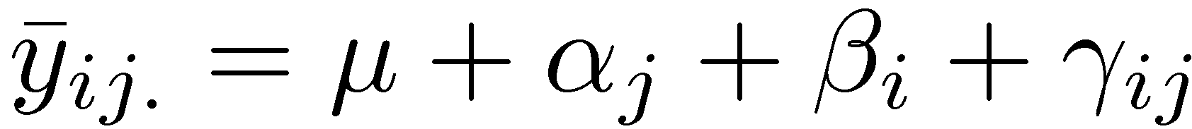
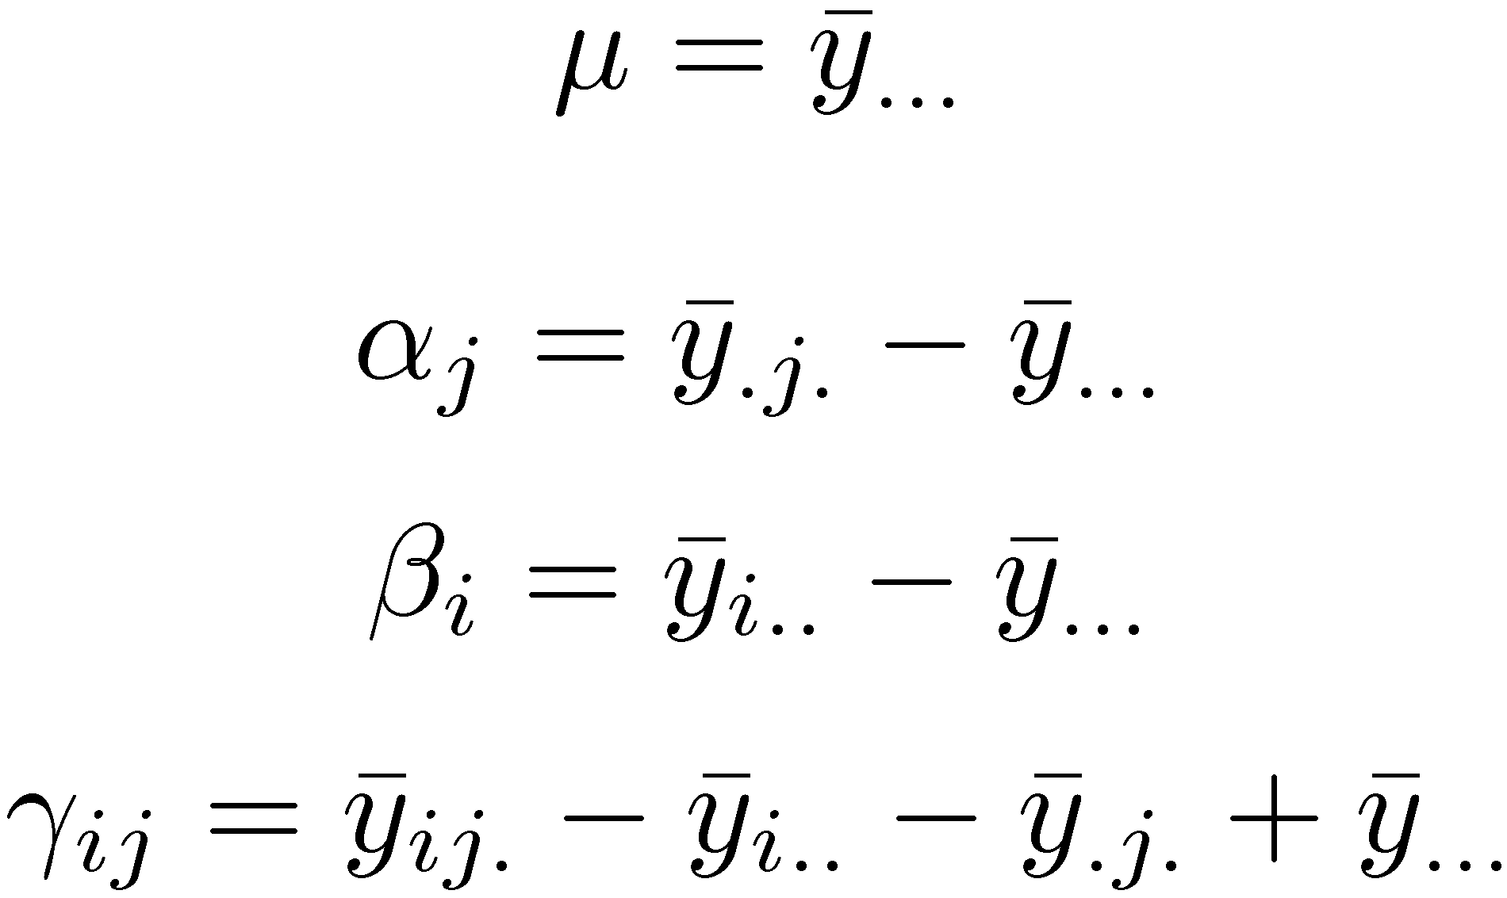
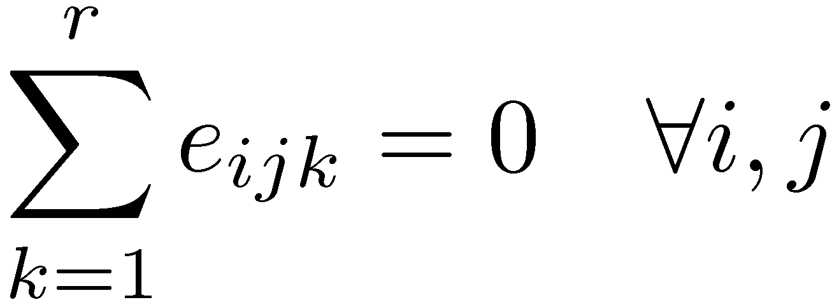
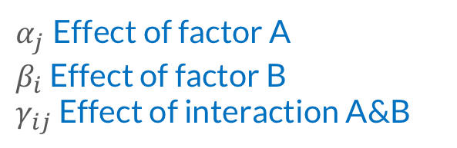
Model for two factorial
Model: With r replications
How to estimate the parameters
$α_{j}$ Effect of factor A
$β_{i}$ Effect of factor B
$γ_{ij}$ Effect of interaction A&B

Slide 25
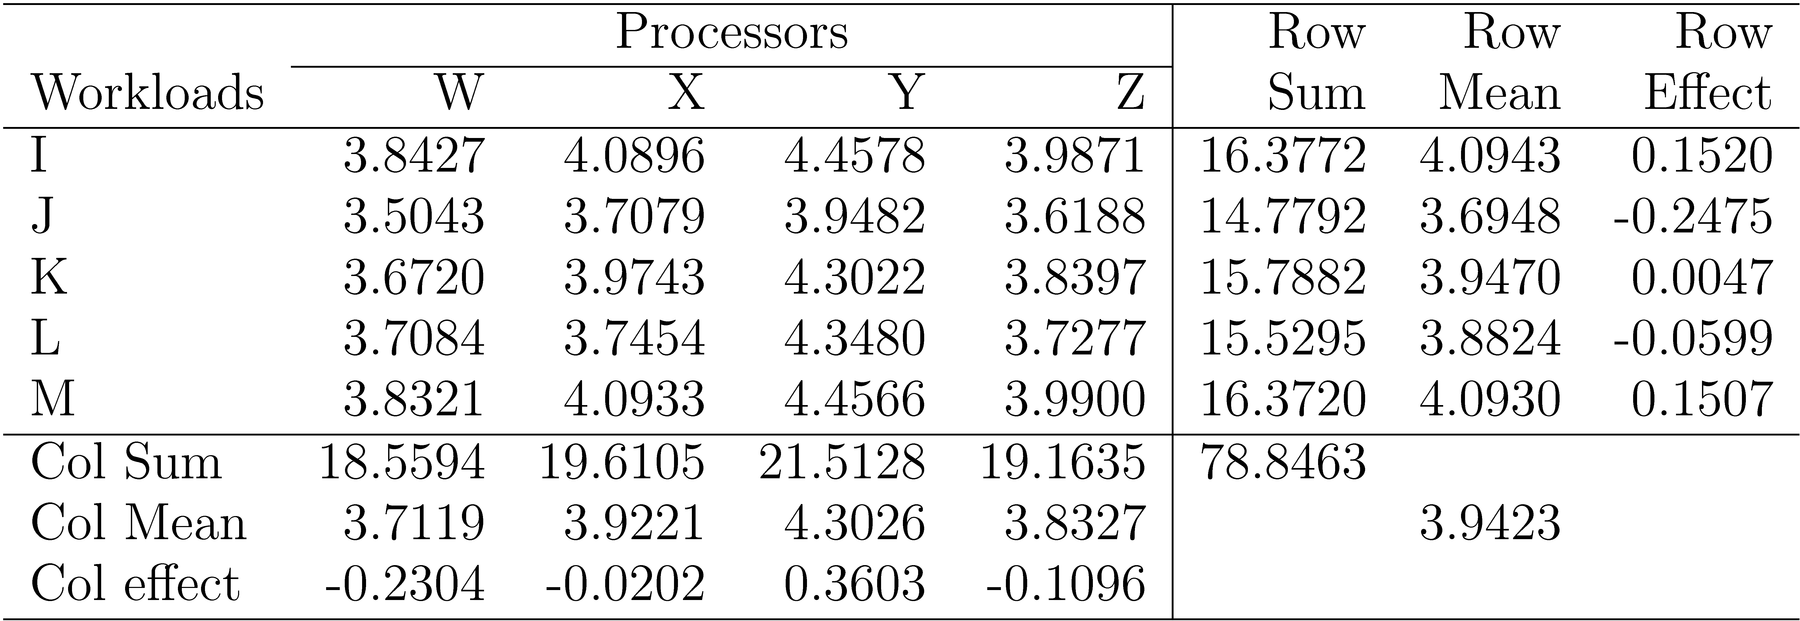
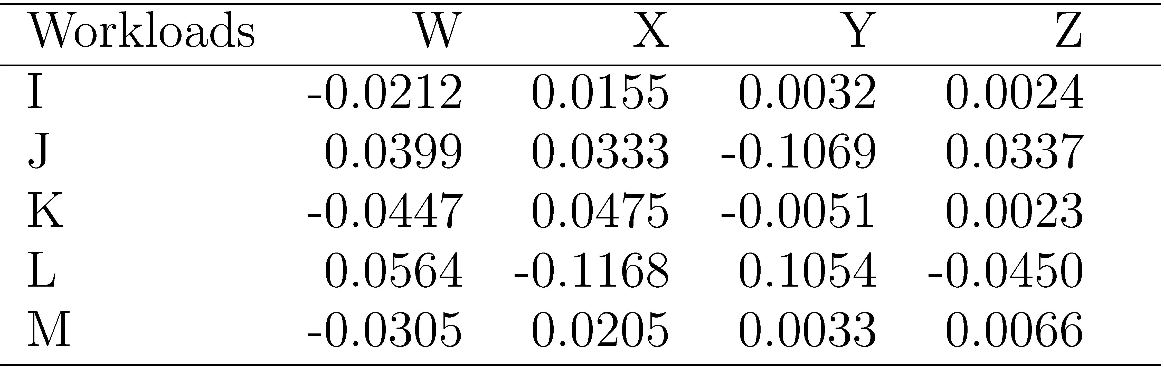
Back to the example
How to interpret them?
Processor W requires 10^{0.23} (=1.69) less code than avg processor.
Processor X requires 10^{0.02} (=1.05) less than an average processor and so on.
The ratio of code sizes of an average workload on processor W and X is 10^{0.21} (= 1.62)
Workload I on processor W requires 0.02 less log code size than an average workload on processor W or equivalently 0.02 less log code size than I on an average processor
Interaction

Slide 26
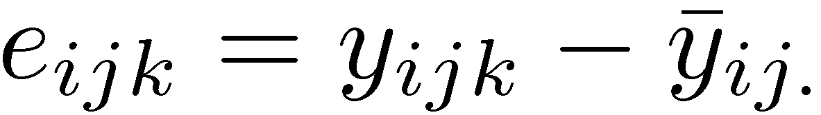
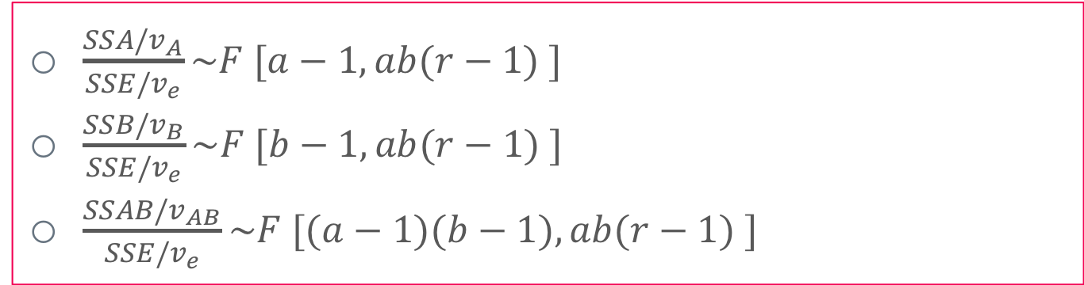
Analyzing the model
$\frac{SSA/v_{A}}{SSE/v_{e}}\sim F [a−1, ab(r−1) ]$
$\frac{SSB/v_{B}}{SSE/v_{e}}\sim F [b−1, ab(r−1) ]$
$\frac{SSAB/v_{AB}}{SSE/v_{e}}\sim F [(a−1)(b−1), ab(r−1) ]$
Compare the variation ratio with F distribution
1. Decompose total of variance
From where? Derive SSY
2. Think about degree of freedom

Slide 27
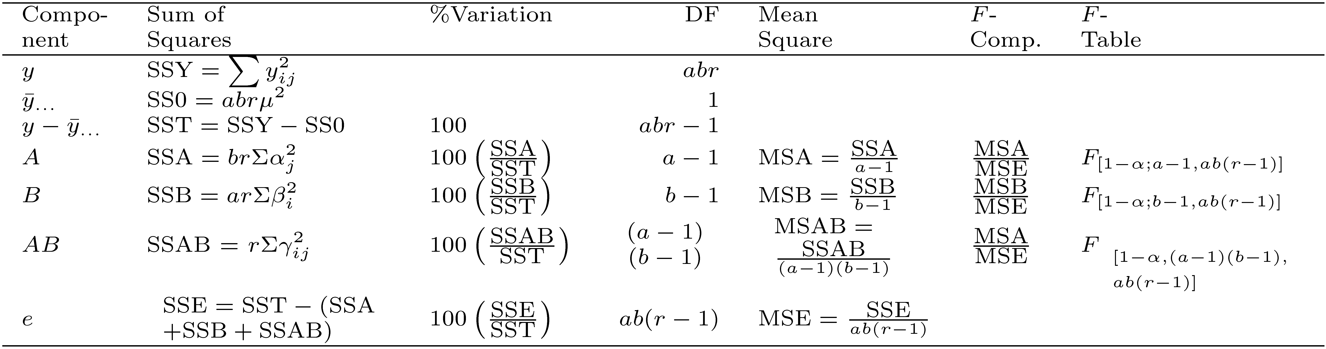
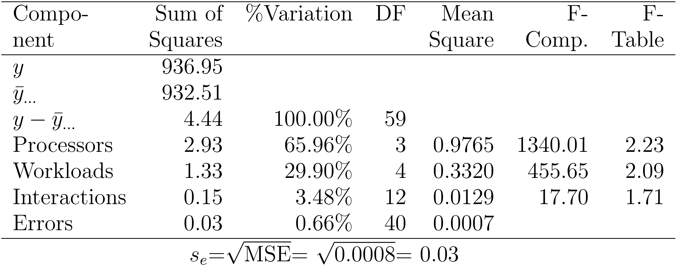
ANOVA for Two Factors w Replications
Standard
output
Back to the example
Are differences significant?

Slide 28
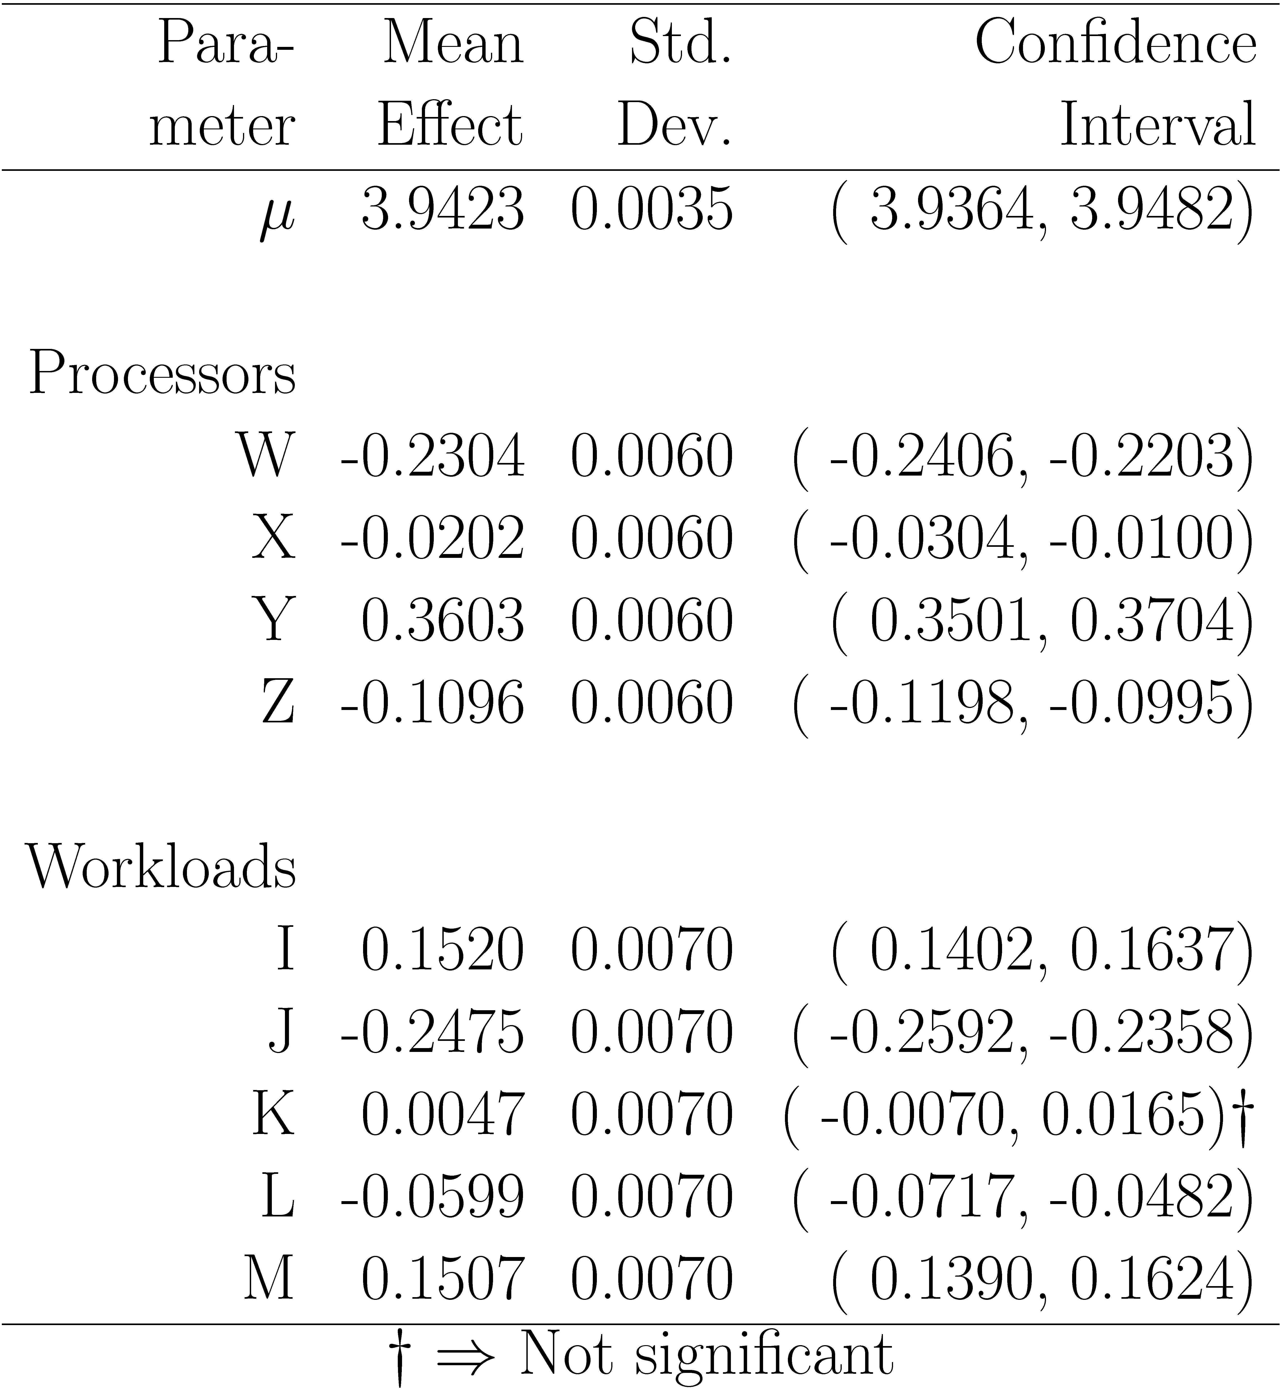
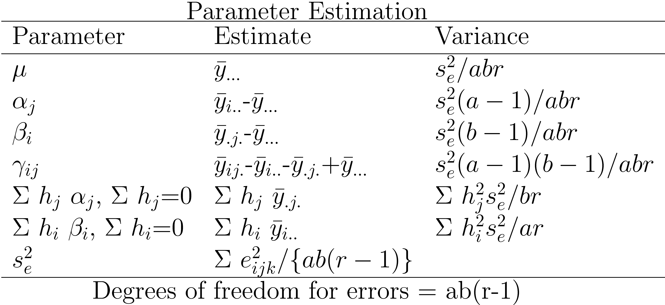
Confidence Intervals For Effects
Use t values at ab(r-1) degrees of freedom for confidence intervals
How

Slide 29
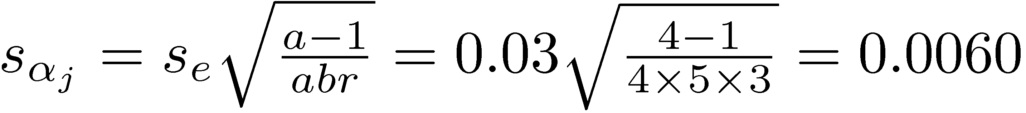
Back to example
From ANOVA table: s_{e}=0.03. The standard deviation of processor effects:
The error degrees of freedom: ab(r-1) = 40 ⇒ use Normal tables
For 90% confidence, z_{0.95} = 1.645 90% confidence interval for the effect of processor W is:
CI. = {-0.2304 +-1.645 * 0.0060, -0.2304 -1.645 * 0.0060}
= (-0.2406, -0.2203)
The effect is significant.

Slide 30

Missing Observations
Recommended Method:
Divide the sums by respective number of observations
Adjust the degrees of freedoms of sums of squares
Adjust formulas for standard deviations of effects
Other Alternatives:
Replace the missing value by such that the residual for the missing experiment is zero.
Use y such that SSE is minimum.

Slide 31
General Factorial Design

Slide 32
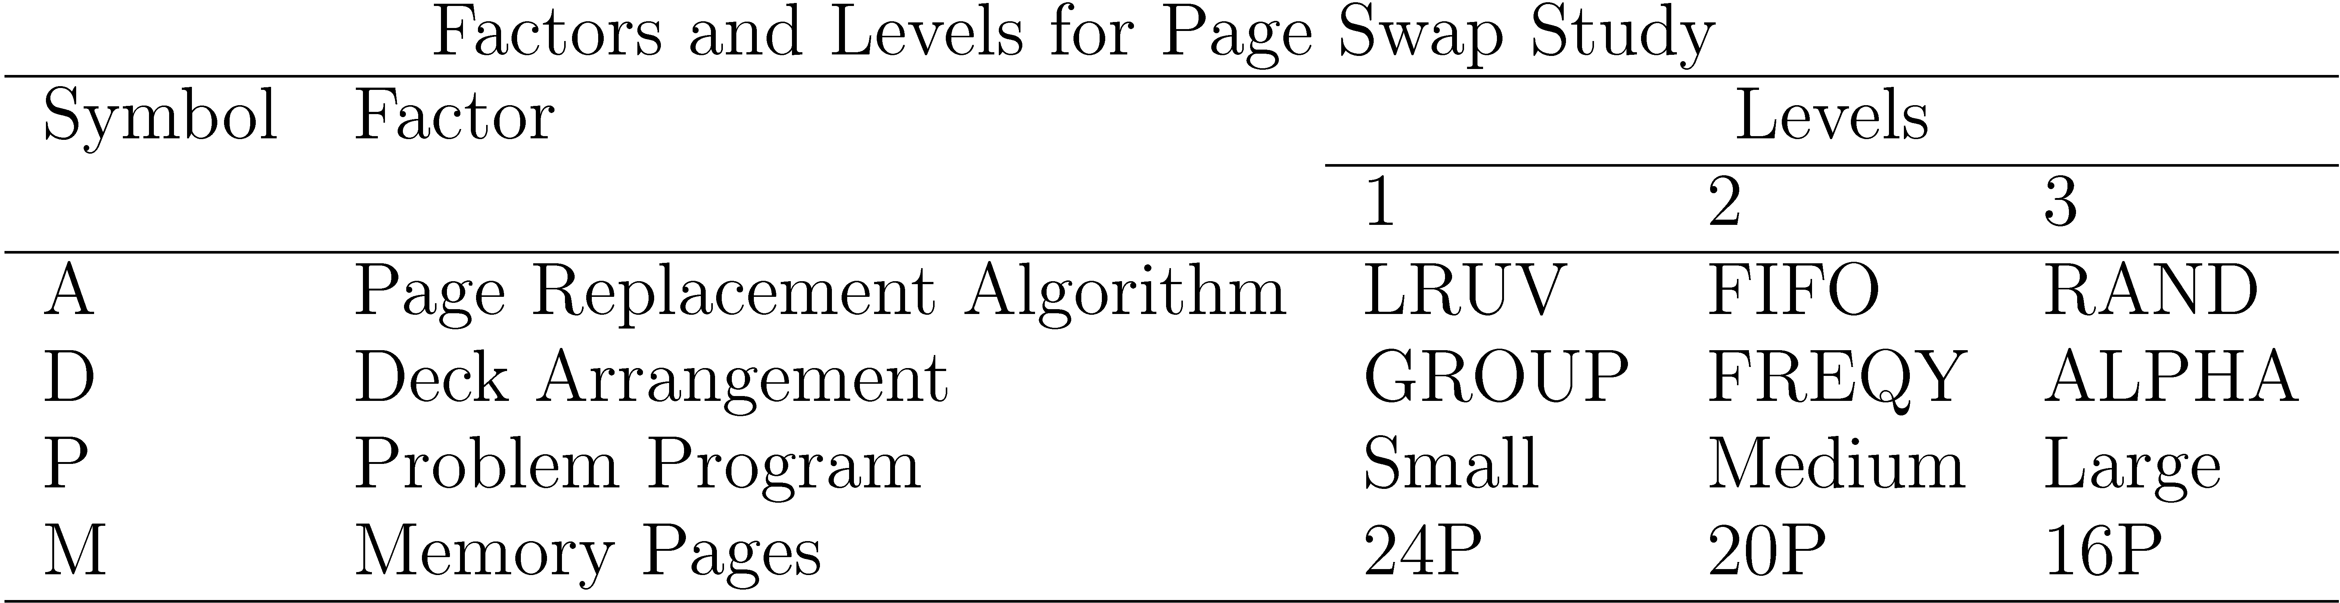
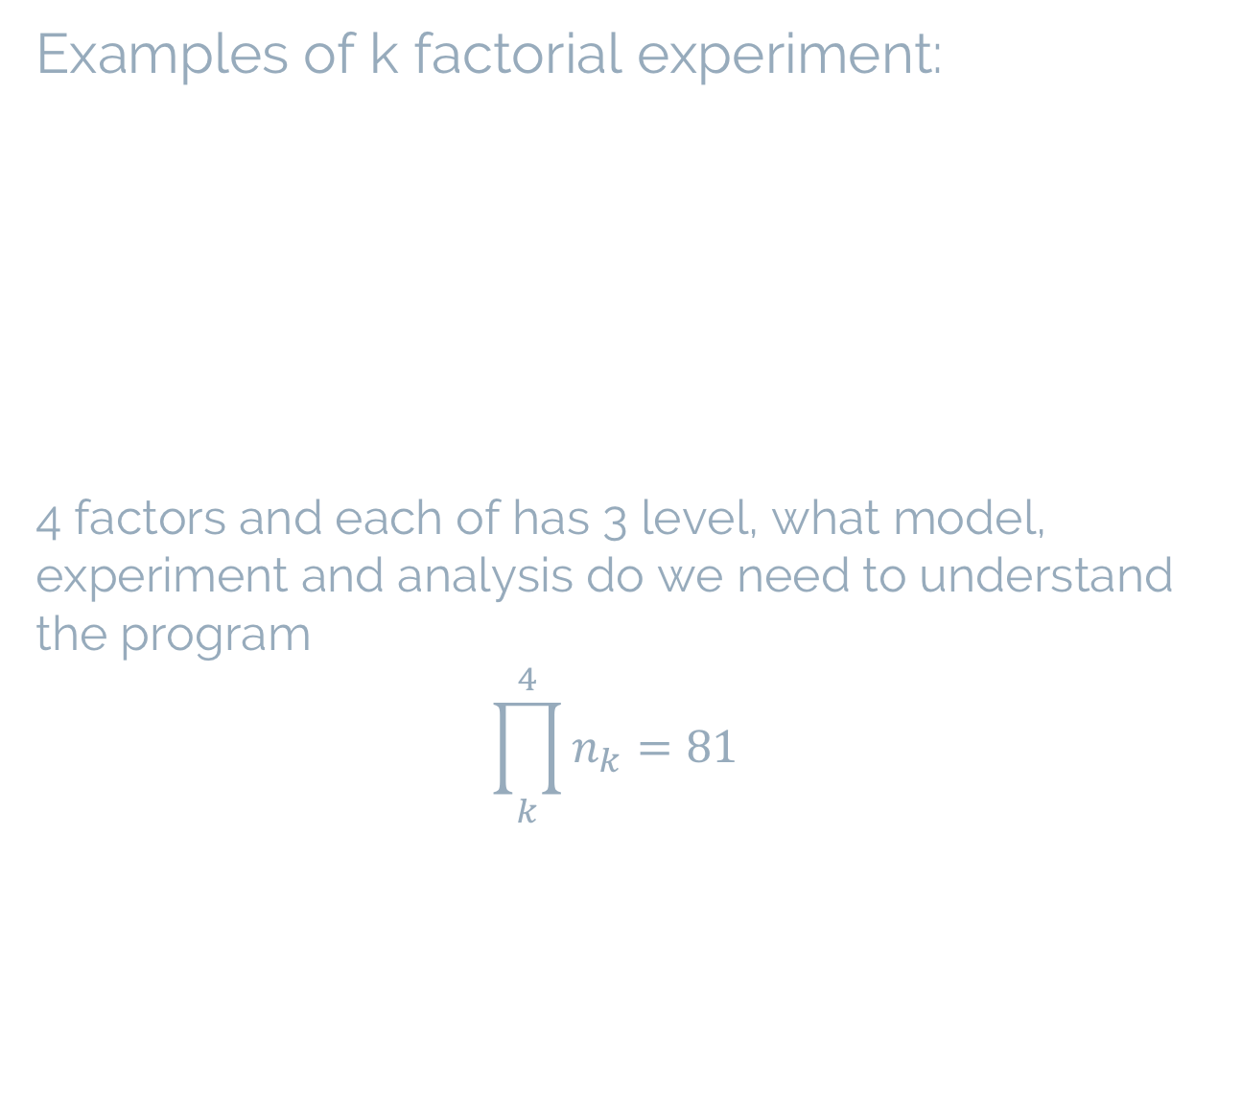
Examples of k factorial experiment: 4 factors and each of has 3 level, what model, experiment and analysis do we need to understand the program $${\prod_{k}^{4}{n_{k}}=81}^{}$$

Slide 33
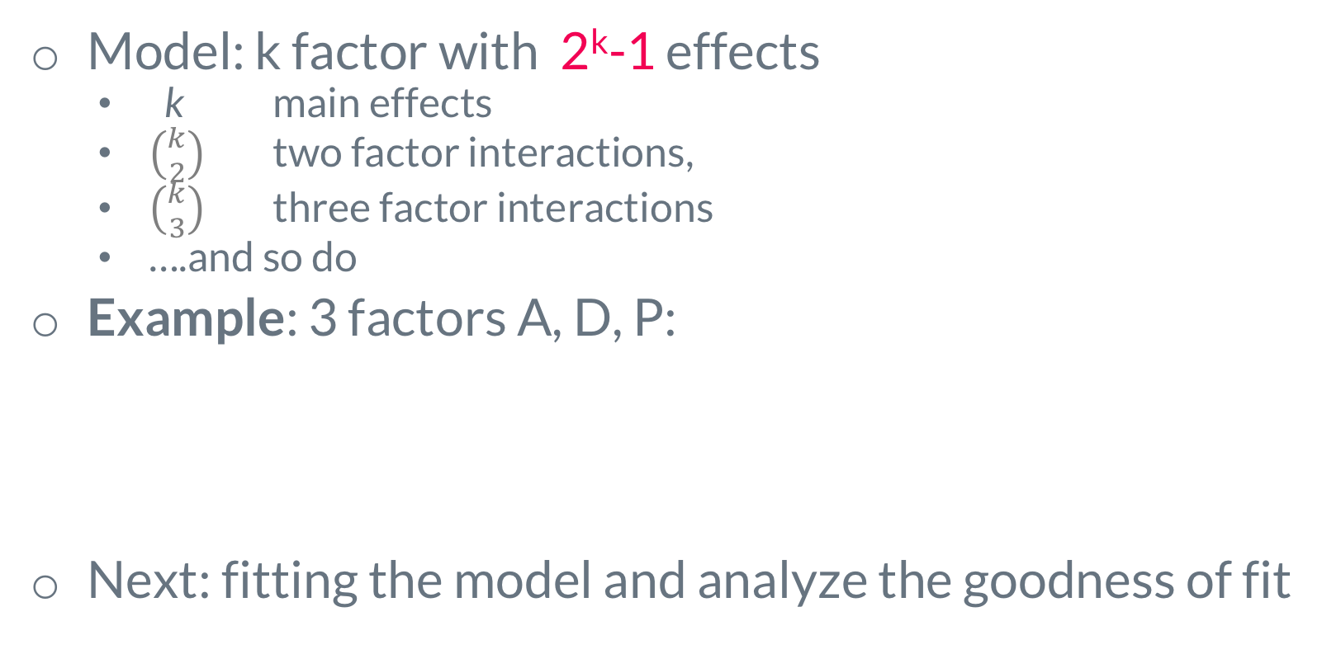
General Full Factorial Designs With k Factors
Model: k factor with 2^{k}-1 effects
k main effects
$\left({k \atop 2}\right)$ two factor interactions,
$\left({k \atop 3}\right)$ three factor interactions
….and so do
Example: 3 factors A, D, P:
Next: fitting the model and analyze the goodness of fit
Explanations to those symbols!!!

Slide 34
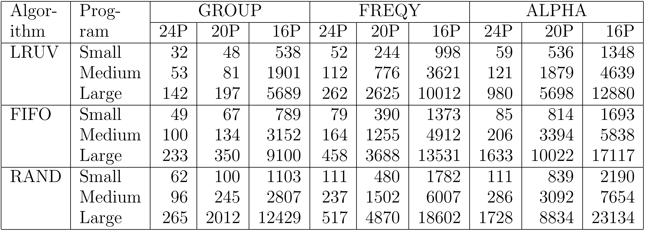
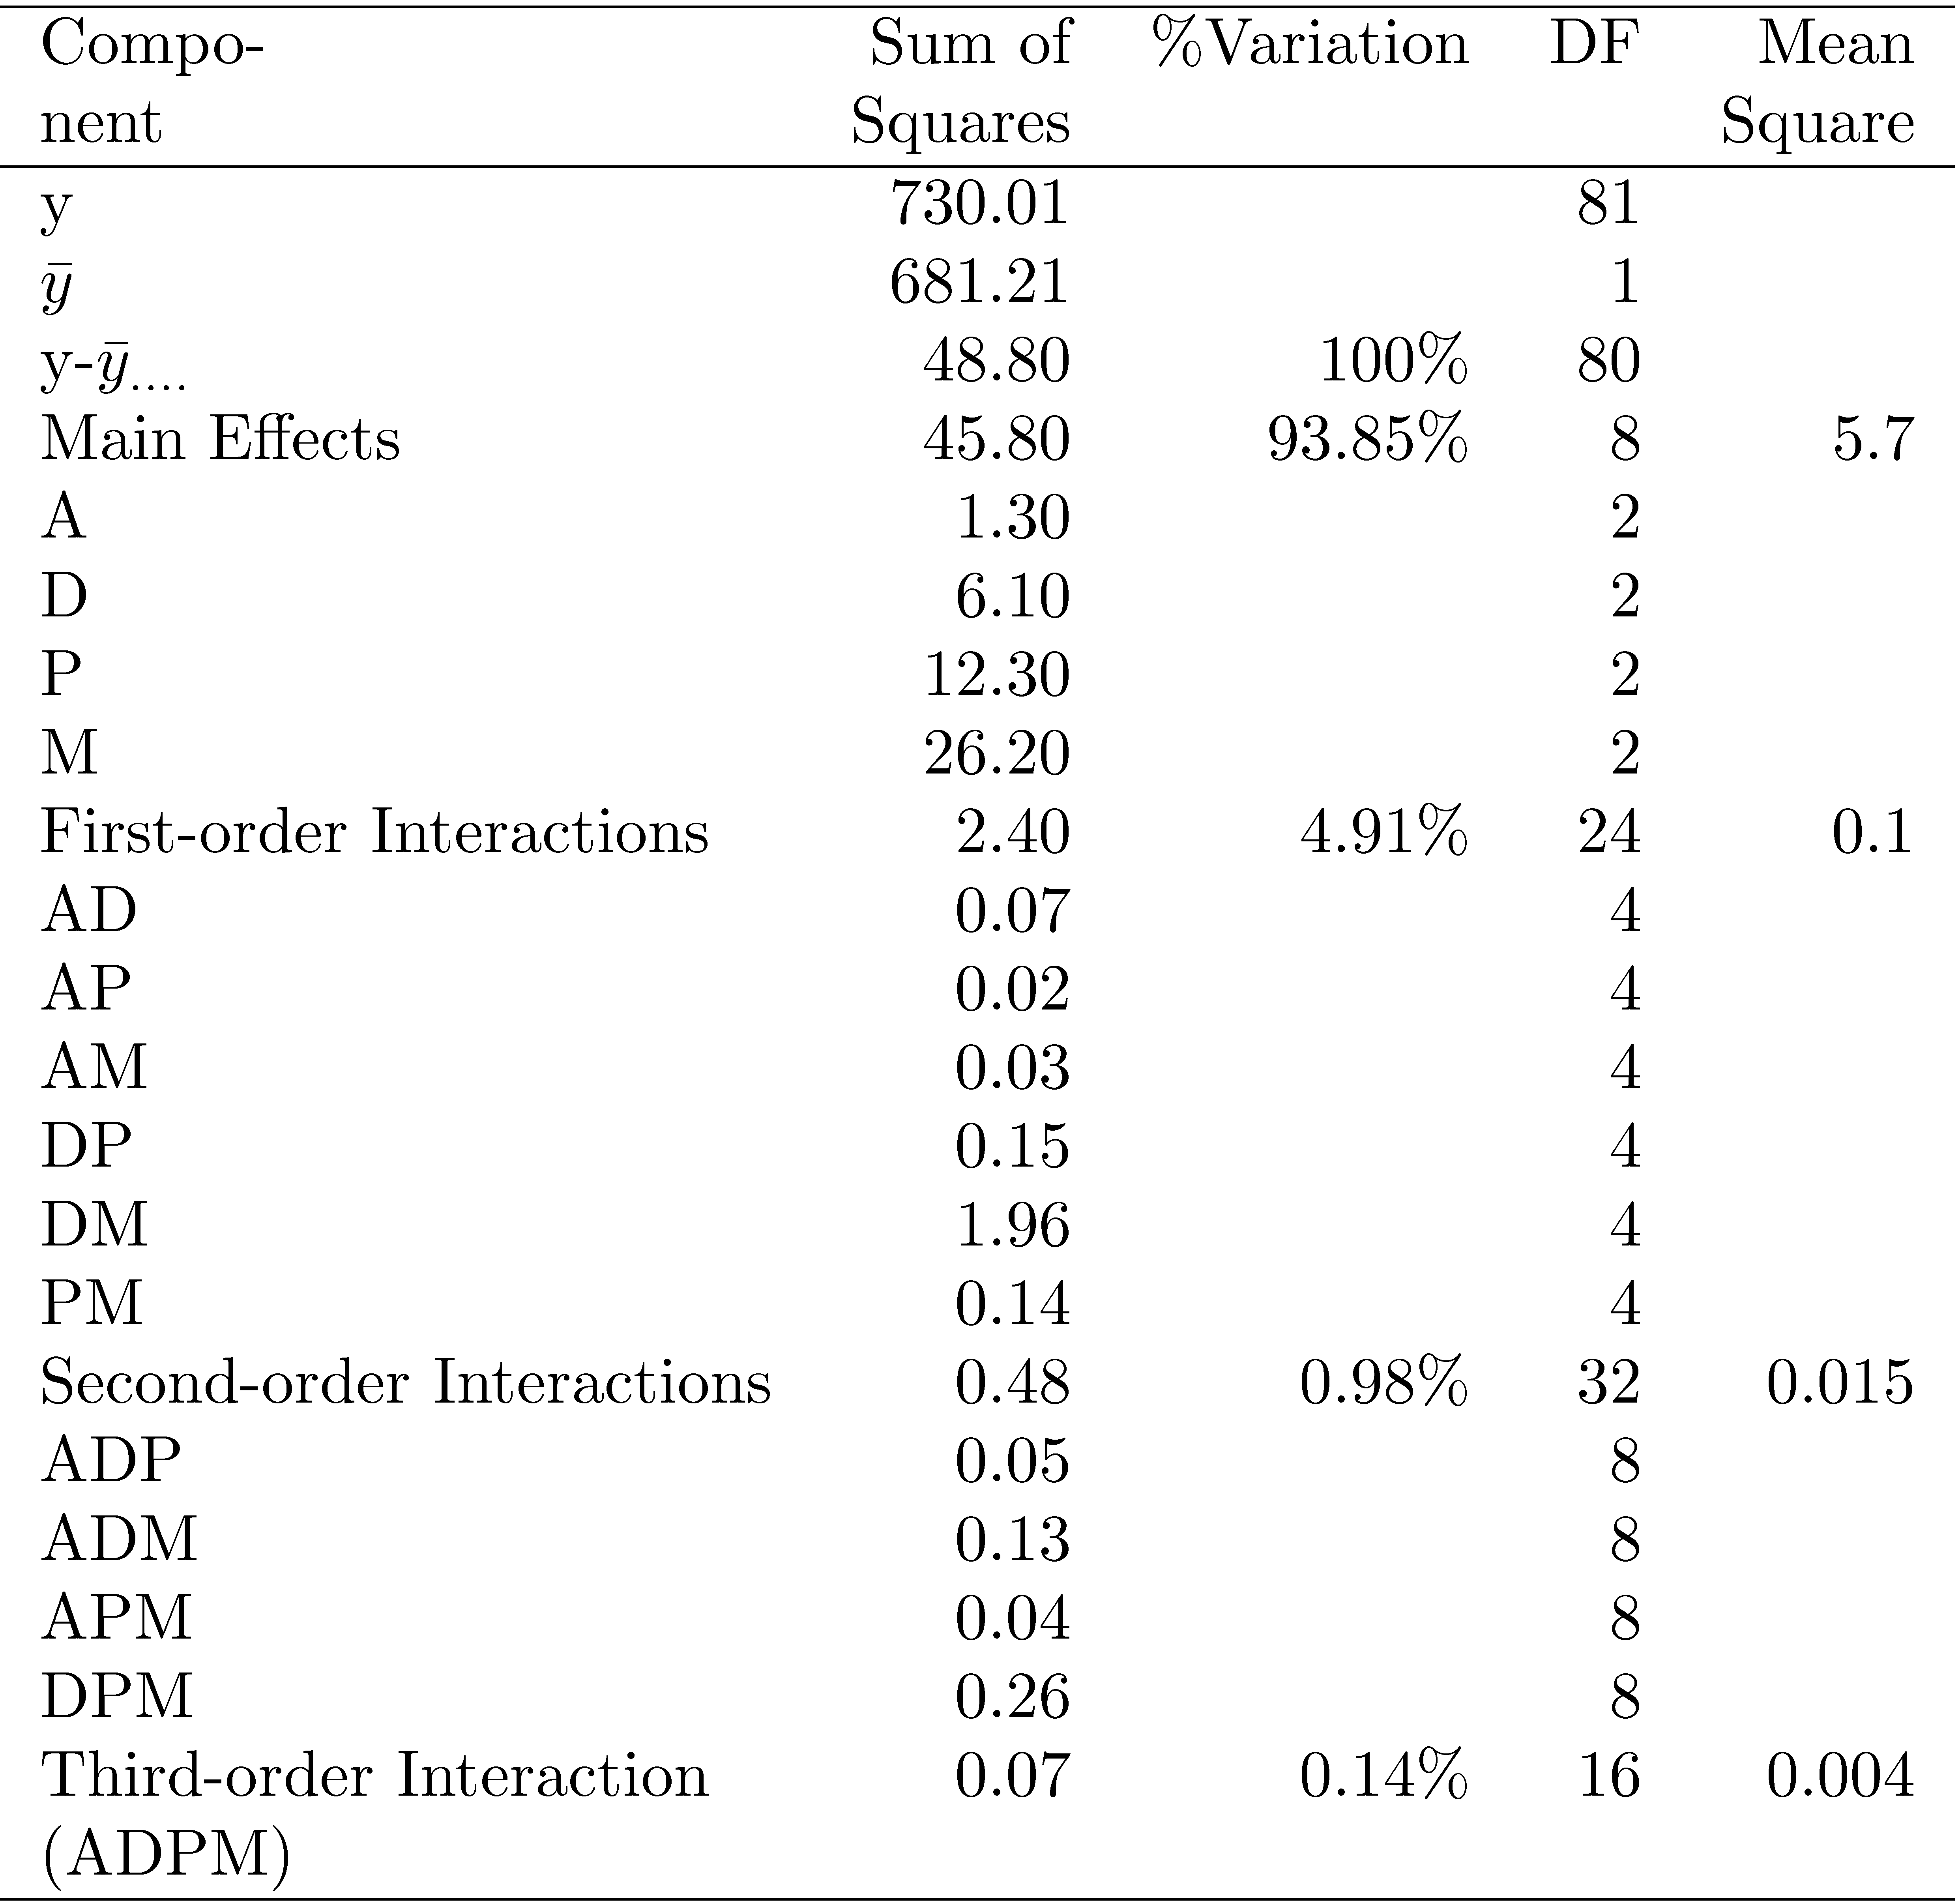
Back to example
Log transformation of the data
Why? y_{max}/y_{min} = 23134/32 = 723
Model:
ANOVA and F-test
Allocating mean square errors (SSE)
SSA^{1st}
SSA^{2nd}
SSA^{3rd}
Degree of freedom
What do you see? significant effect?
Any suggestion?
4 one-factor
6 two-factor interactions,
4 three-factor interactions, and
4 four-factor interaction.

Slide 35
Back to example
Simpler model: removing the insignificant term
ANOVA analysis and F-test (Insert the results)
Checking the assumption: Normal distribution

Slide 36
Bonus quiz

Slide 37
Related homework
Exercise 6.4, 7.4

Slide 38

Want big impact?
Use big image.

Slide 39
Thanks!
Any questions?
lydiaychen@ieee.org

Slide 40
Credits
Special thanks to all the people who made and released these awesome resources for free:
Presentation template by SlidesCarnival
Photographs by Unsplash

Slide 41
Presentation design
This presentations uses the following typographies and colors:
Titles: Raleway
Body copy: Lato
You can download the fonts on these pages:
https://www.fontsquirrel.com/fonts/raleway
https://www.fontsquirrel.com/fonts/lato
Dark blue #2185c5
Light blue #7ecefd
Yellow #ff9715
Magenta #f20253
Dark gray #677480
Light gray #97abbc
You don’t need to keep this slide in your presentation. It’s only here to serve you as a design guide if you need to create new slides or download the fonts to edit the presentation in PowerPoint®

Slide 42
SlidesCarnival icons are editable shapes.
This means that you can:
Resize them without losing quality.
Change fill color and opacity.
Change line color, width and style.
Isn’t that nice? :)
Examples:

Slide 43
😉
Now you can use any emoji as an icon!
And of course it resizes without losing quality and you can change the color.
How? Follow Google instructions https://twitter.com/googledocs/status/730087240156643328
✋👆👉👍👤👦👧👨👩👪💃🏃💑❤😂😉😋😒😭👶😸🐟🍒🍔💣📌📖🔨🎃🎈🎨🏈🏰🌏🔌🔑 and many more...

